Slide 1
Authentication and Key Establishment Protocols
LAKSHMY K.V
Amrita Vishwa Vidyapeetham

Slide 2
Roadmap
Intorduction
Background and Definitions
  Authentication
  Key Establishment
Case Study: Attempt to design a secure key establishment protocol
  Example protocols 1-5
  Security Assumptions

Slide 3

Why do we have Protocols for Authentication and Key Establishment?
Modern cryptography is based on keys
  Kerckhoffsprinciple:
    a cryptosystem should be secure even if everything about the system, except the key, is public knowledge
  If the keys are not secure, the whole system is not secure, even if secure crypto algorithms are used
Cryptographic algorithms for encryption and integrity cannot perform their function unless
  secure keys have been established, and
  the users know which party share these keys

Slide 4
Importance
Authentication and key establishment are fundamental building blocks for securing electronic communications
  The notions
    “Establishing a secure channel”, or
    “Starting up a secure session”
  means that the keys have been established and the involved parties have been authenticated
  So, protocols for authentication and key establishment are performed at the beginning of the each session

Slide 5
Roadmap
Intorduction
Background and Definitions
  Authentication
  Key Establishment
Case Study: Attempt to design a secure key establishment protocol
  Example protocols 1-5
  Security Assumptions
Goals of Authentication and Key Establishment
  Basic Goals
  Enhanced Goals

Slide 6
Authentication
The notion authentication depends on the context of usage
  It applies to both entities and information itself
Entity authentication (EA)
  Process of verifying that an identity is as claimed
Message authentication (MA)
  A message delivered over a channel should be authenticated as to origin (who sent the data) and data content.
  Methods of providing message authentication
    Message Authentication Codes (MACs)
    Digital signatures
  In this course we focus on entity authentication!

Slide 7
Entity Authentication (EA)
Definition: Entity authentication is the process whereby one party (verifier)
  is assured of the identity of the second party involved in the protocol through acquisition of corroborative evidence (PROOF), and
  that the second party has actually participated in the protocol (FRESHNESS!)
Difference “Identification” and “Authentication”
  Identification: Claimed or stated identity
    Example: Access to a computer system
    Enter your user name; User = “Lakshmy” (stated identity)
  Authentication: Proved identity
    Example: Enter your password (prove that you are user “Lakshmy” ), or scan your fingerprint

Slide 8
More Notions about Authentication
Unilateral/mutual authentication
  Unilateral: One party proves its identity to the other
  Mutual: Both parties prove their identities to each other
Authentication can be based on
  what you have (e.g., hardware token)
  what you are (biometrical data e.g., fingerprint, face, iris)
  what you know (e.g., password, key)
Authentication can be realized with interactive challenge‐response protocols

Slide 9
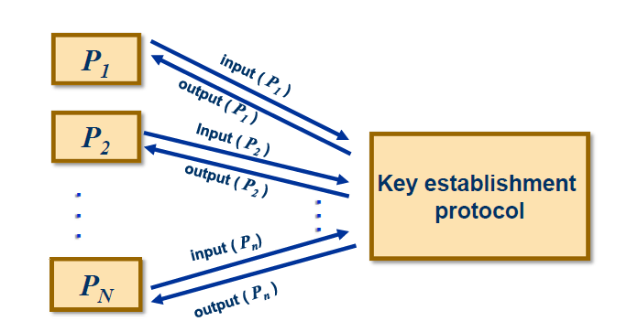
Key Establishment
Definition
  Key establishment is a process or protocol whereby a shared secret (key) becomes available to two or more parties, for subsequent cryptographic use
Basic idea of a key establishment protocol

Slide 10
Types of Key Establishment
A key establishment protocol can be
  Key agreement
    A shared key is derived by two or more parties as a function of the contributions (inputs) of all parties
    No party can predetermine the resulting value
  Key transport
    One party creates or otherwise obtains the secret key, and securely transfers it to the other(s)
    The trust model is very important
  Hybrid key establishment
    Key agreement protocol for some parties
    Key transport protocol for the others
All types of key establishment can be realized by both symmetric and asymmetric cryptographic techniques

Slide 11
Types of Cryptographic Keys
Long term keys (LTK)
  Key shared between the parties with validity of “long” time period (e.g., 1 month, 1 year)
  Typically used for authentication purposes
Short term keys (STK, session keys)
  Session key is a short lived secret, i.e., its usage is restricted to a short time period (e.g., single telecommunication session), after which all trace of it is eliminated
  Advantages of session keys
    Limiting available ciphertext for cryptanalysis
    Limiting exposure in the case of key compromise
    Avoiding long‐term storage of large number of distinct secret keys by creating keys only when they are actually required
    Creating independence across communication sessions and applications

Slide 12
Key Management
Key management is more general notion then a key establishment
  Once keys have been established, they should be managed in order to provide a secure communication
Key management consists of establishment, update, storage, backup, recovery, and revocation of cryptographic keys
Although one of the most important aspects of any cryptographic system, key management is most often neglected

Slide 13
Authenticated Key Establishment (AKE)
What does “secure” key establishment mean?
  Each party in a KE protocol should be able
    to determine the true identity of the other(s) which could possibly gain access to the resulting key,
    implying preclusion of any unauthorized additional parties from deducing the same key
Authenticated key establishment (AKE)
  Combines authentication and key establishment in one protocol
  After an AKE, each party is assured that no unauthorized party has access to the established session key (key authentication)

Slide 14
General Principle
Establishment of authenticated session keys is not possible without the availability of secure channels!
  Possibilities to establish a new session key:
  All parties already share a cryptographic key
  A trusted online server must be accessible
    Each party must share a key with the trusted online server
    To transfer information between the parties it might be necessary to pass it through a chain of online servers
  A trusted offline server must be available
    E.g., via certified public keys

Slide 15
Roadmap
Intorduction
Background and Definitions
  Authentication
  Key Establishment
Case Study: Attempt to design a secure key establishment protocol
  Example protocols 1-V
  Security Assumptions

Slide 16
Assumptions
We assume that all cryptographic primitives used in the protocols are secure
  In the protocols we analyze, some of the best state‐of‐the art algorithms for encryption, digital signatures, message authentication codes (MACs) or hash functions
We search the security problem in the protocol itself, not in the used primitives
  We want to show that secure cryptographic primitives are not enough for secure protocols
    Protocols fail often because their messages are not good composed
    We analyze the protocol messages and the operation done by each protocol party, as well as the trust model

Slide 17
Non-maleable Encryption Schemes
Requirements to the encryption scheme: We assume that it should not be possible to specifically alter the content of encrypted messages
  Feature: Non‐malleability of the underlying encryption scheme
  E. g., Adversary should not be able to change the encrypted identifier in the message enc_{K}(K_{AB}, I_{B} )

Slide 18
Model and Main Requirements
Model:
  Involved parties: A and B
  Goal: A and B want to obtain a new session key K_{AB}
  A and B do not share a long term key
  A trusted third party T must be involved
      T always acts as it is intended to
      Role of T here:
      to generate the new key and to transport it to A and B
  Main goals / requirements
    MR1:K_{AB} is only known to A and B and A (B)are assured that only the other party B (A) knows the key (except T)
    MR2:A and B should be assured that the key K_{AB} is newly generated

Slide 19
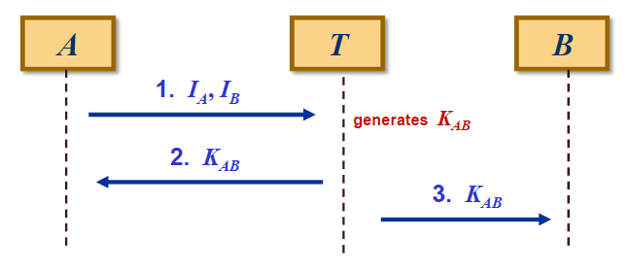
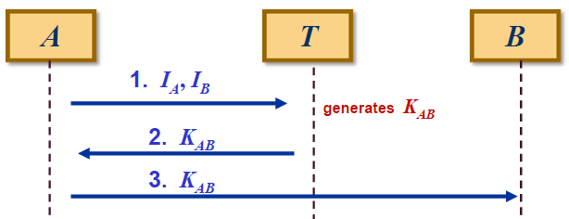
Protocol I
I_{A} is the identity of the party A
I_{B} is the identity of the party B
Identity: e.g., network address or name, certificate
Alternative of Protocol I:
To disburden T, the key K_{AB} may be passed from A to B
(This spares one connection between T and B)

Slide 20
Protocol I: Description
Step 1:
  A starts the protocol by telling T the identifiers I_{A} and I_{B} of the communicating parties
  T creates a session key K_{AB} to be used for the secure communication between A and B
Step 2:
  T sends K_{AB} to A as plaintext
Step 3:
  T sends K_{AB} to B as plaintext

Slide 21
Protocol I: Analysis
Adversary Model
  The adversary is able to eavesdrop all messages on the communication channel
Problems/Attacks:
  Obviously anyone has access to the session key K_{AB}
Countermeasure:
  Establish a secure channel using the long‐term secret keys
    K_{AT} between A and T and,
    K_{BT} between B and T
  Next attempt: Protocol II

Slide 22
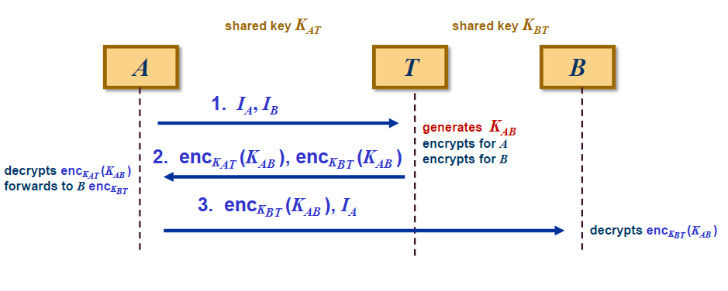
Protocol II: Flow
Fe
Features
  Adversary should not be able learn K_{AB} since we assume the underlying encryption scheme to be secure
  Adversary only sees encrypted messages and thus does not learn K_{AB}

Slide 23
Protocol II: Description
Step 1:
  A starts by sending identifiers I_{A} and I_{B} of the communicating parties to T
  T then generates a session key K_{AB} and encrypts it with K_{AT} and K_{BT} respectively
Step 2:
  T sends both ciphertexts to A
Step 3:
  A forwards the ciphertext encrypted with K_{BT} to B
  A adds its identifier I_{A} to inform B about who else has the key

Slide 24
Protocol II: Analysis
Adversary Model:
  In addition to eavesdropping, the adversary can control the communication channel and thus is able to alter messages or their destination
Problems:
  All kinds of man‐in‐the‐middle‐attacks
    see next slides…

Slide 25
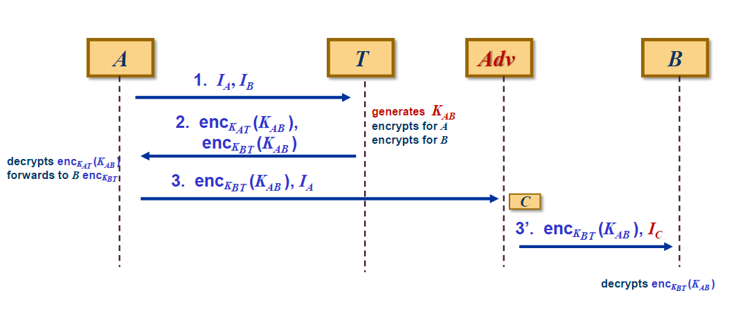
Protocol II: First Attack
Adv masquerades as C to B

Slide 26
Protocol II: Analysis of the First Attack
Attack (man‐in‐the‐middle)
  Adv intercepts message intended for B and replaces I_{A} with I_{C}
    Adv masquerades as C to B
    C might be an arbitrary identity chosen by the adversary
  B now believes it shares the key K_{AB} with C
    in fact, B shares K_{AB} with A!
Violated requirements
  Depends on application
    B might give information to A which only should have been revealed to C
  Adv does not necessarily obtain the session key
    however, the requirement MR1 is not fulfilled since B does not know with whom it shares the session key

Slide 27
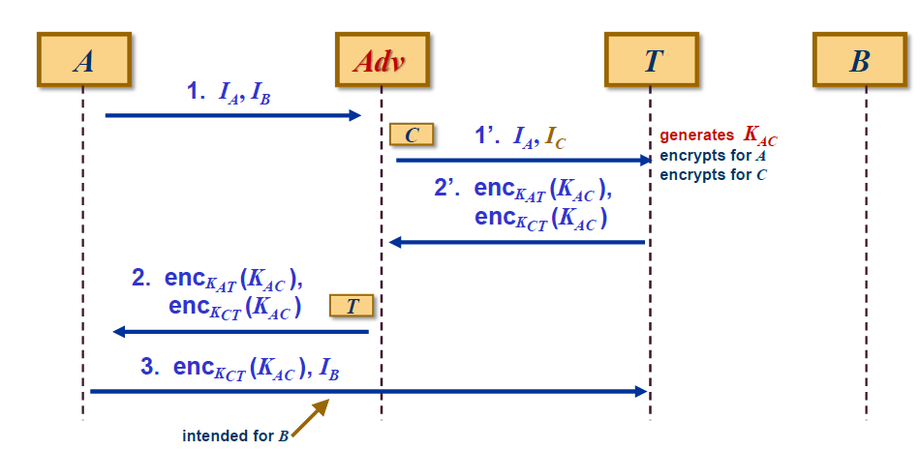
Protocol II: Second Attack
Adv interferes in the communication between A and T

Slide 28
Protocol II: Analysis of the Second Attack
This attack is successful when Adv is known to T
  Adv is an insider and known by T as C and thus shares K_{CT} with T
Adversary Model
  The adversary is allowed to be an insider or a collusion of an insider and an outsider
Attack (man‐in‐the‐middle)
  Adv intercepts message 1 intended for T and replaces I_{B} with I_{C}
    Adv masquerades as C to T
    C might be an arbitrary identity chosen by the adversary
  Result: A now believes it shares the key K_{AC} with B
    in fact, A shares K_{AC} with C!
    MR1 is not fulfilled

Slide 29
Protocol II: Analysis of the Second Attack (cntd.)
Consequences
  At the end of the attack Adv masquerades as B to A
  A believes to share the session key with B but actually shares it with Adv
    K_{AC} represents the session key accepted by A
    A cannot distinguish encrypted messages and thus does not notice the manipulation
  Adv knows the session key K_{AC}
    Adv is able to capture all information intended for B
Possible countermeasure
  Cryptographically bind IDs of the entities to the corresponding session key
    see example protocol III

Slide 30
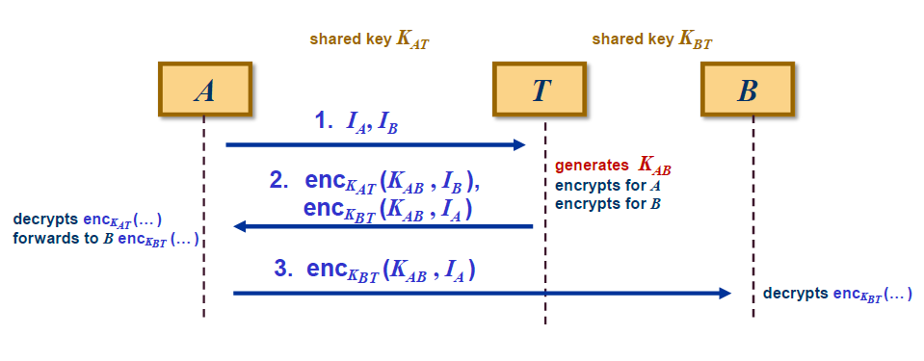
Protocol III: Flow
Comparison with Protocol II: Here, the identities of the participants are bound to the session key!

Slide 31
Protocol III: Description
Step 1:
  A starts by sending identifiers I_{A} and I_{B} to T
  T then generates a session key K_{AB} and encrypts K_{AB} together with the identity of the peer party
    For A : enc_{KAT}(K_{AB}, I_{B} )
    For B : enc_{KBT}(K_{AB}, I_{A} )
Step 2:
  T sends both ciphertexts to A
  A decrypts enc_{KAT}(K_{AB}, I_{B} ) and obtains the key K_{AB}
Step 3:
  A forwards the ciphertext encrypted with K_{BT} to B
  B decrypts enc_{KBT}(K_{AB}, I_{A} ) and obtains the key K_{AB}

Slide 32
Protocol III: Discussion
Features
  IDs of the participants are cryptographically bound to the session key
Both previous attacks do not work anymore
  Because of the non‐malleability of the underlying encryption scheme it is not possible to alter the content of encrypted messages, i.e., the adversary is not able to change the encrypted identifiers in message 2 and 3: enc_{KAT}(K_{AB}, I_{B} ), enc_{KBT}(K_{AB}, I_{A} )

Slide 33
Protocol III: Discussion (cntd.)
Role of the encryption enc_{KAT}(K_{AB}, I_{B} ):The encryption scheme enc here should achieve much more that confidentiality
  Confidentiality
    The encryption should hide the new session key K_{AB}
  Authenticity:
    A can be sure that this message have been generated by T, since only T knows the key K_{AT} and can encrypt with it
  Cryptographically binding
    The encrypted message parts K_{AB} and I_{B} are bound to each other
  Integrity
    If the encryption scheme enc has the feature of non‐malleability, it is not possible to manipulate the ciphertextand change it in order to achieve some desired plaintext (e.g. to change I_{B} in I_{C})

Slide 34

Protocol III: Problems
Adversary Model
  The adversary is allowed
    to use messages recorded in any previous run of the protocol
    to obtain the session key of any previous run of the protocol
Problems
  Reuse of old protocol messages or message fields from pervious protocol runs (replay attack)
  Adversary might also be in possession of old session keys
    Old session keys are vulnerable to attacks because
      they may be used with a variety of regular data formats (might make cryptanalysis easier)
      they may be stored at insecure locations (e.g., RAM) or discarded carelessly after the session

Slide 35
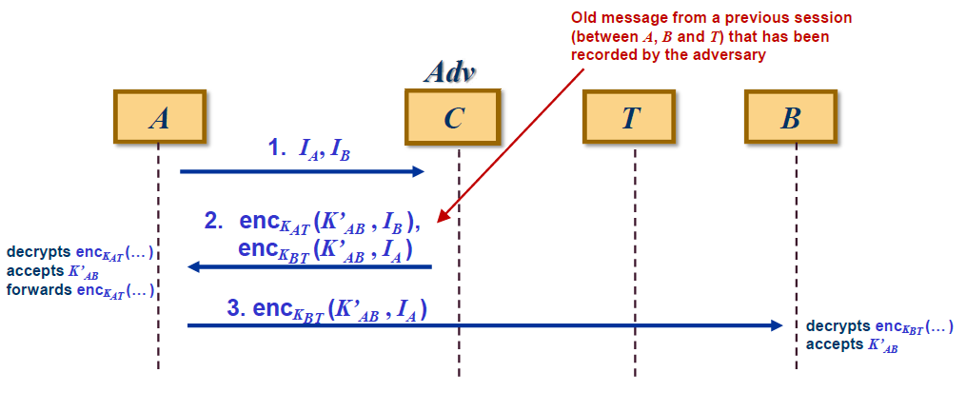
Protocol III: Replay Attack
The adversary Adv :
-intercepts the message 1 intended for T
-injects an old message 2 containing an old session key K’_{AB}

Slide 36
Protocol III: Analysis of the Attack
Consequence of the replay attack
  Adv makes A and B to use an old session key K’_{AB}
Adversary might know K’_{AB}
  Then Adv is able to decrypt or alter all messages encrypted with K’_{AB}
Remarks
  The attack is successful even if K’_{AB} is unknown to Adv since Adv forces A and B to accept an old session key
  If the attack has been successful, the adversary might
    obtain more ciphertext created with K’_{AB} for crypt‐analysis or even
    decrypt sessions protected by K’_{AB}

Slide 37

Protocol III: Possible Countermeasures against Replay Attacks
There are several possible measures against replay attacks (see the coming slides):
  each party has its fresh own input to the key generation
  nonces
  timestamps
  sequence numbers
One possible solution: Use of nonces
  Nonce: A (random) value N which is generated by one party and returned by the other party and which is cryptographically bound (e.g., via encryption) to a message m

Slide 38
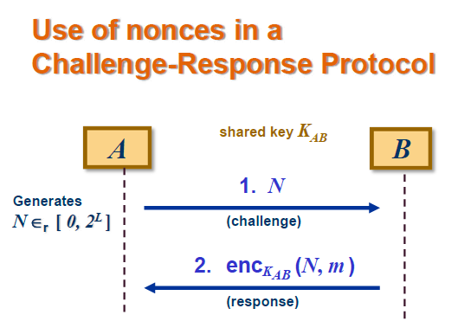
Basic Idea of Using Nonces
Assumption: Only A and B share key K_{AB}
  1. A randomly chooses nonce N and sends it to B
  2. B cryptographically binds it to its message m, e.g., by encrypting it with K_{AB}
  3. If message 2 contains N, A knows, that B must have participated in the current protocol run (since only B knows K_{AB} and thus only B was able to include N into message 2)

Slide 39
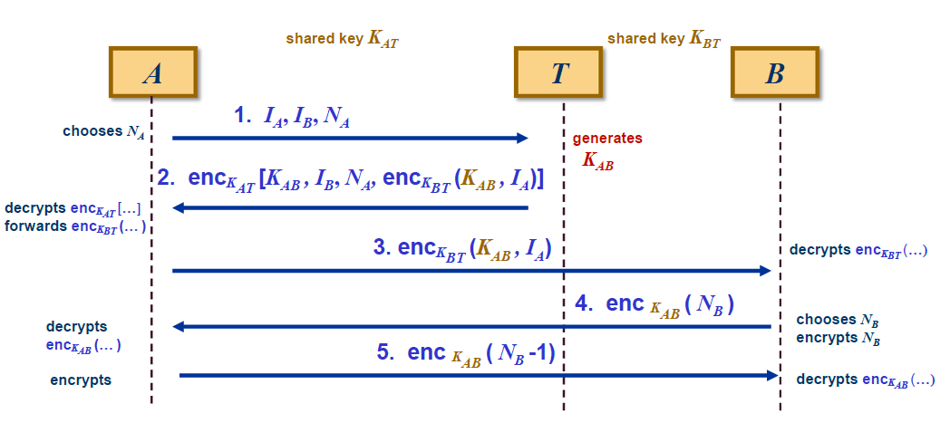
Protocol IV (Needham‐Schroeder Protocol): Flow

Slide 40
Neednam‐Schr. Protocol: Description (1)
Step 1:
  A starts the protocol by sending its own identifier I_{A} and the identifier I_{B} of its intended communication partner B to T
  T creates a session key K_{AB} for the secure communication between A and B
  T first encrypts the session key K_{AB} and I_{A} with K_{BT}
  then T encrypts K_{AB}, NA, I_{B} and the message encrypted with K_{BT} with K_{AT}
Step 2:
  Upon receipt of message 2, A decrypts with K_{AT} and obtains K_{AB}
  T is trusted ⇒only T(and A) knows K_{AT} required to create message 2
  Therefore, if message 2 contains
    Nonce NA, A can deduce that the message, and thus K_{AB} must have been recently created by T(T is trusted ⇒K_{AB} has been newly created)
    Identifier I_{B}, A can deduce that T has correctly received the identifier I_{B} of A’s intended communication partner B ⇒ only B(except A and T) will be able to get K_{AB}(since T only encrypts K_{AB} with K_{BT} and K_{AT})

Slide 41
Neednam‐Schr. Protocol: Description (2)
Step 3:
  A forwards the message encrypted with K_{BT} to B
  Upon receipt of message 3 party B
    knows that A must have known this message (since only A knows K_{AT} to decrypt message 2)
    knows that A must have obtained K_{AB}(since message 2 also included K_{AB})
    decrypts it with K_{BT} and obtains K_{AB}
  If message 3 contains I_{A}, B knows that K_{AB} is to be shared with A
    T is trusted ⇒only T(and B) knows K_{BT} required to include I_{A} into message 3
      ⇒B knows, that only A can get K_{AB}(since T only encrypts it with K_{AT} and K_{BT})

Slide 42
Neednam‐Schr. Protocol: Description (3)
Step 4:
  B generates a nonce NB, encrypts it with K_{AB} and sends the corresponding ciphertext to A
  A decrypts NB using K_{AB}, decrements it, re‐encrypts it with K_{AB} and sends the corresponding ciphertext to B
Step 5:
  Upon receipt of message 5, B decrypts with K_{AB}
  If message 5 contains NB‐1, then B can deduce that the current communication partner must be in possession of K_{AB} in order to create this message
    Note that B has no assurance of the freshness of K_{AB}(see next slides…)

Slide 43
NS Protocol: Problems
Situation about key freshness:
  A is assured that K_{AB} has been newly generated if message 2 contains its nonce NA
  What about B ?
Question: How is B able to get confidence in key freshness of K_{AB}?
  B does not directly communicate with T
  A should transfer this confidence in the challenge‐and‐response part between A and B(messages 4 and 5)
  However, this assumes that only A is able to create message 5
  This assumption is not reasonable since an adversary might be in possession of an old session key (replay attack)!

Slide 44
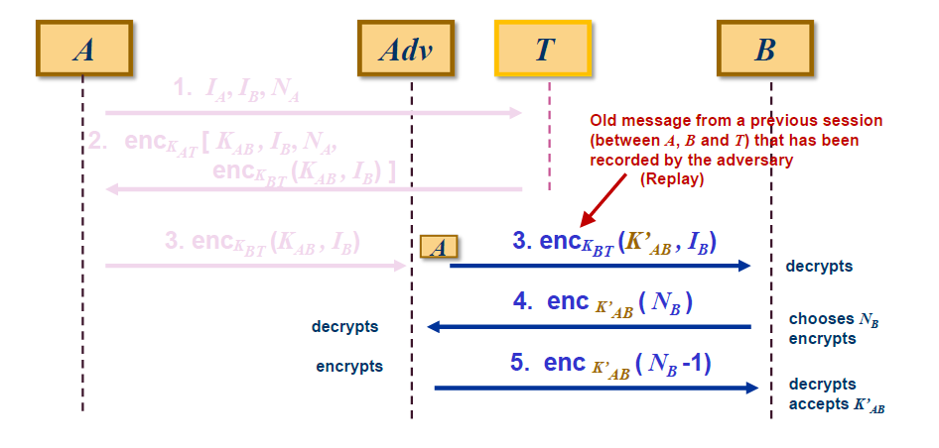
Denning‐Sacco Attack on NS‐Protocol
Assumption: Adv knows an old session key K’_{AB} between A and B
Attack: Adv masquerades as A to B and makes B to accept an old session key

Slide 45
Avoiding the Attack on the NS‐Protocol
Countermeasure
  Both A and B send their nonces to T, so that the key generated by T can be cryptographically bound also with B’s nonce
    ⇒Freshness assurance for B
Protocol modification
  B sends nonce NB to A
  A adds its nonce NA and queries T
  Reply from T can be checked on key freshness by A and B
  ⇒Bauer‐Berson‐Feiertag(BBF) protocol

Slide 46
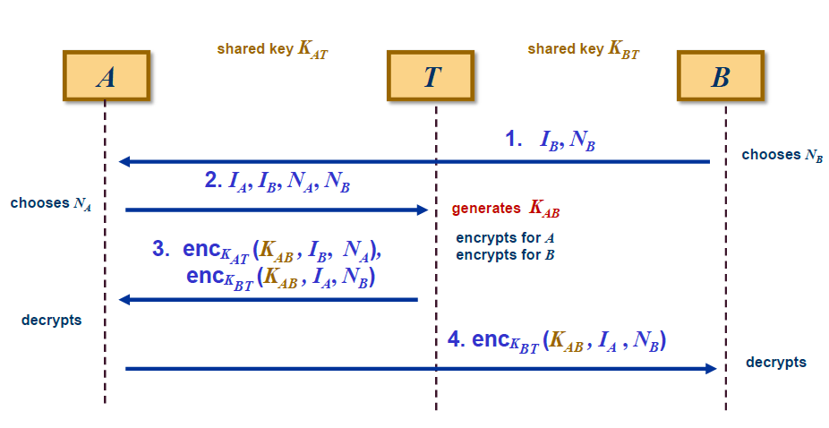
Protocol V: Bauer‐Berson‐Feiertag(BBF) Protocol

Slide 47

BBF Protocol: Discussion
The Denning‐Sacco Replay attack is not possible any more
  ⇒Freshness assurance for B
The BBF Protocol does not provide key-confirmation
  This means, that A and B cannot be sure whether the other party has correctly received K_{AB} after a successful protocol‐run
  Exercise
    Extend the BBF protocol such that A and B can be sure that the other party has received K_{AB} correctly!
    Other problems with the BBF Protocol?

Slide 48
Summary: Adversary Model
Assumption 1: The adversary is able to eavesdrop all messages on the communication channel
Assumption 2:The adversary can control the communication channel and thus is able to alter messagesor their destination
Assumption 3:The adversary is allowed to be an insider or a collusion of an insider and an outsider
Assumption 4:The adversary is allowed
  to use messages recorded in any previous run of the protocol
  to obtain the session key of any previous run of the protocol

Slide 49


